Slide 1
Introduction to Rates
EQ – How do I find the rate?

Slide 2
Learning Objectives
Understand what a rate is
Writing a comparison as a rate.

Slide 3
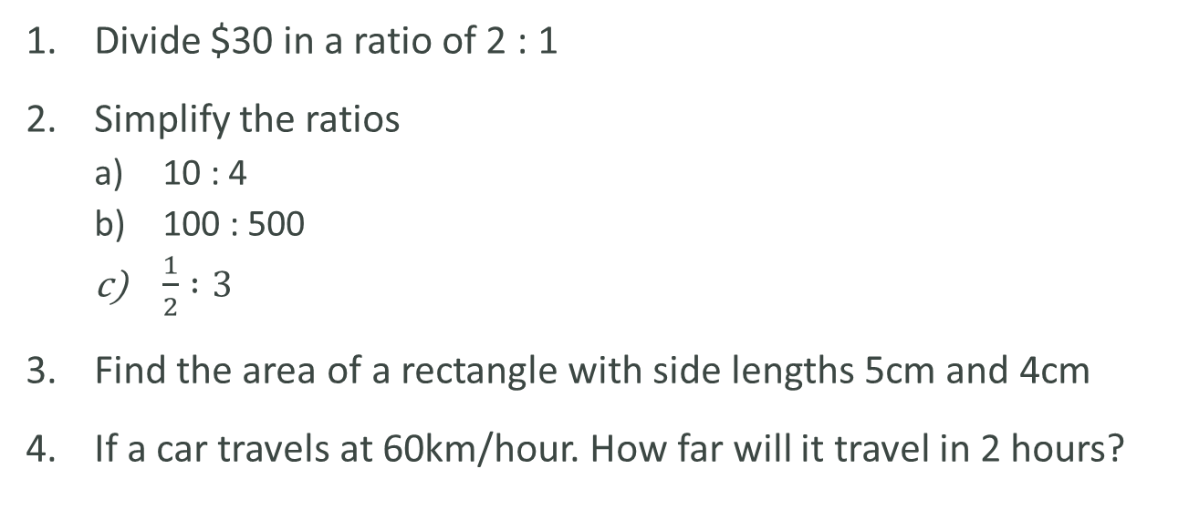
Introduction to Rates
EQ – How do I find the rate? ?
Task:
Divide $30 in a ratio of 2 : 1
Simplify the ratios
10 : 4
100 : 500
$\frac{1}{2} :3$
Find the area of a rectangle with side lengths 5cm and 4cm
If a car travels at 60km/hour. How far will it travel in 2 hours?
10m
13m

Slide 4
24 7 30
Introduction to Rates
EQ – How do I find the rate? ?
What are rates?
A rate compares related quantities with different units.
Rates are usually written with one quantity compared to a single unit of the other.
For example
50km per 1 hour
(written like 50km/h)

Slide 5
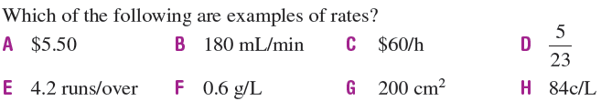
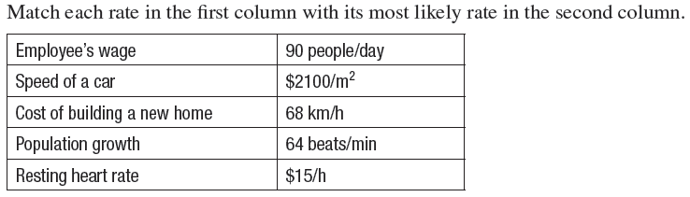
Let’s try some together

Slide 6

24 7 30
Date
Introduction to Rates
EQ – How do I find the rate? ?
What are rates?
A rate compares related quantities with different units.
Rates are usually written with one quantity compared to a single unit of the other.
For example
50km per 1 hour
(written like 50km/h)
How do we find the rate?
To find the rate we need to work out what one of that unit will be.
To do this we need to divide both numbers by the second number
So the rate is $15 per hour = $15/h

Slide 7
Now your turn!
Complete the worksheet
Page 360 Cambridge Textbook

